Slide 1


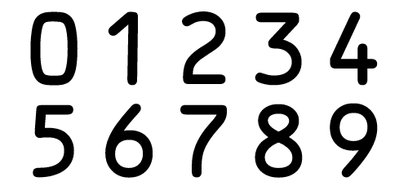
Neural Network for Digit Classification
Objective: To classify a handwritten digit in a given image.
Machine Learning technology: Neural Network
Dataset: MNIST dataset
Potential Areas of Use: Self Driving Cars, Robotics
Siva Kongara
Shaishavkumar Jogani

Slide 2
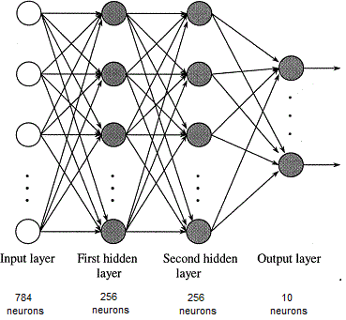
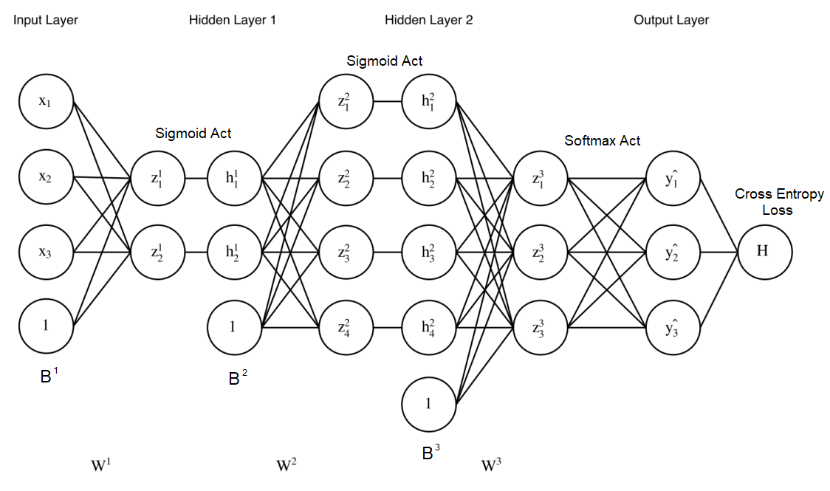
Structure of Our Neural Network
784 (input) – 256(H1) – 256(H2) – 10 (Output)
Normalized input (Divided by 255)
Sigmoid Activation at each hidden layer
Softmax Activation at output layer
Cross entropy loss
Network Parameters
Weights: W1, W2, W3
Biases: B1, B2, B3
Data size: Training 10k, Validation 5k, Test 5k

Slide 3
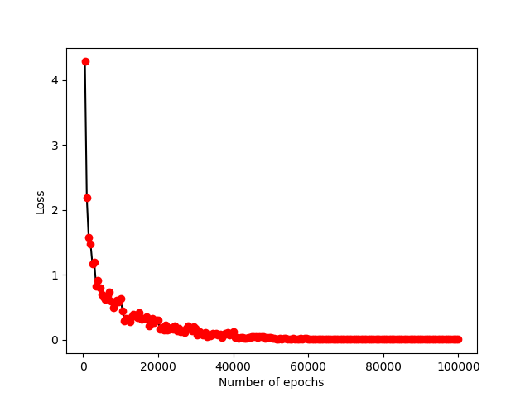
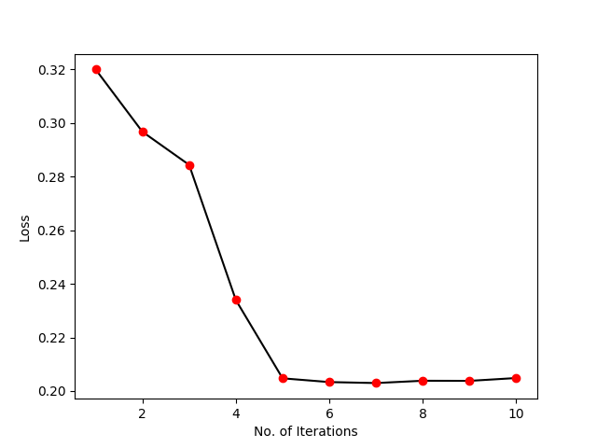
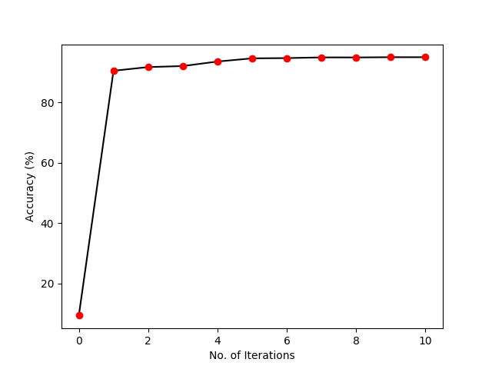
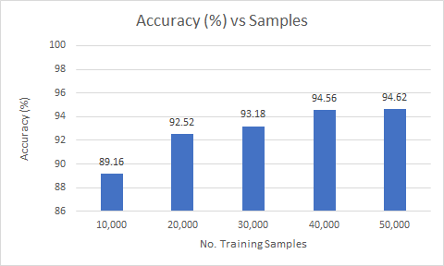
Results

Slide 4
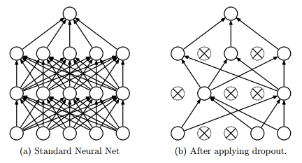
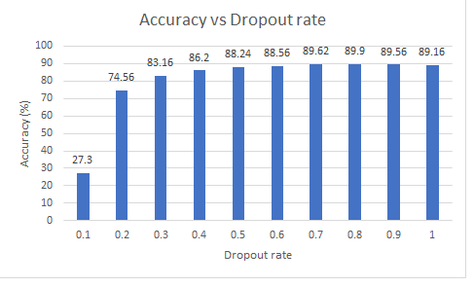
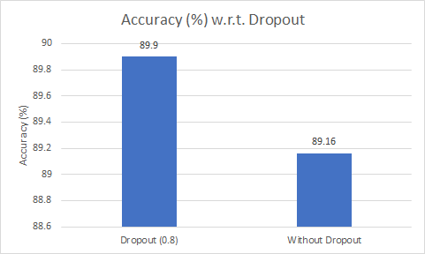
Dropout Regularization to avoid Overfitting
Max Accuracy for 0.8
Dropout improved the accuracy in Testing

Slide 5
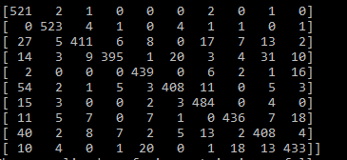
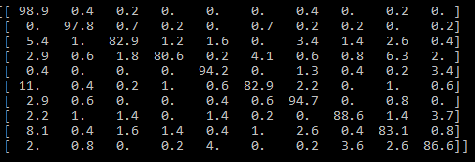


Confusion Matrix
Normalized Confusion Matrix
0 1 2 3 4 5 6 7 8 9
0 1 2 3 4 5 6 7 8 9
0
1
2
3
4
5
6
7
8
9
0
1
2
3
4
5
6
7
8
9
As we can see from the confusion matrix
3 is confused with 8
5 is confused with 0
8 is confused with 0

